Slide 1
MscRcmnd - Music Recommender
Laboratory of Advanced Programming A.Y. 2023/2024
Emanuele Roncioni 1914914 - Emilio Martino 1715650 - Giuseppe Fosci 1855832 - Eric Welmillage 1871952 - Alessio Rago 1840854 06/11/24

Slide 2
Index
Project overview, objectives
Containerization architecture
Development process ?
ER schema, mockups
Description
Mockups
Environments
Implementations

Slide 3
Project overview and objectives

Slide 4
Project overview and objectives
Music Recommender is a web service that relies on a small network of containerized lightweight REST servers to provide a user friendly music recommendation system.

Slide 5
Project overview
Containerization:
Each required functionality has its own dedicated container.
Containers communicate with each other to perform their functions.
Technologies:
Containers run Flask web servers, acting as a REST API endpoint
Container-to-Container communication happens via JSON formatted response bodies

Slide 6
Rationale
How is it containerized?
The system intends to rely on two Docker networks: Internal and Interface Net, separating the containers that elaborate and gather data (Internal) and the ones that interface with the users.
Why REST and JSON?
Allows for exchange of data with a consistent format for which Python has built-in support.
Why Flask?
In retrospect, not the best choice, but it provided the most familiar to the largest percentage of participants.

Slide 7
Containerization architecture

Slide 8
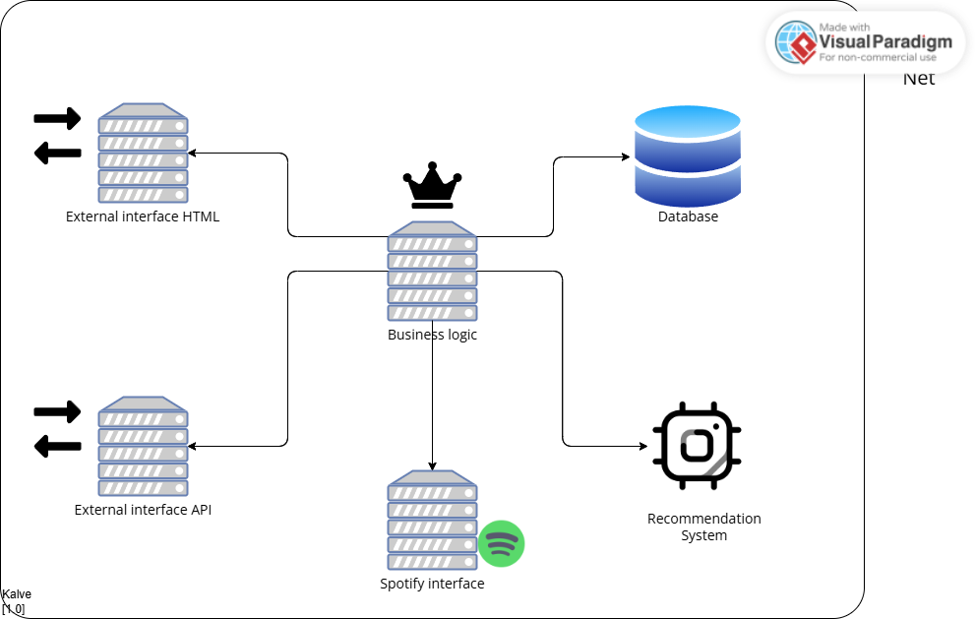
Container Model

Slide 9
Containerization Architecture
Business Logic:
The main core of the application, it composes and elaborates the data from the DB, the recommendation system and the external interfaces so it can be served to users.
Can be easily replicated thanks to containerization, avoiding single points of failure.
Interfaces:
The API and HTML interfaces allows users to access the service via 2 different endpoints.
Thanks to the common business logic container, a large amount of code can be reused, and these interfaces just filter the data so it’s suitable for the business logic container.

Slide 10
Containerization Architecture
Recommendation System:
The container that actually generates recommendations, using the scikit-sklearn library on a ~30Mb music dataset based on Spotify’s “song characteristics”.
The generated data is served via a Flask webserver operating on the same container towards BusinessLogic.

Slide 11
Other containers
Spotify Interface
Communicates with the Spotify APIs to provide song snippets, links and data.
Database
MySQL database accessed via the SQLAlchemy library

Slide 12
Development process

Slide 13
Development process
SCRUM-Based approach, operating within 3 virtual sprints, Stretching the 2 weeks max time to about 1 month per sprint
Initial difficulties in keeping time taken for tasks within expected parameters
Second sprint cut short by second semester exam season, remaining stories merged into third to start a “clean slate”.
Third sprint far closer to real Sprint, with about 3 weeks of development time.

Slide 14
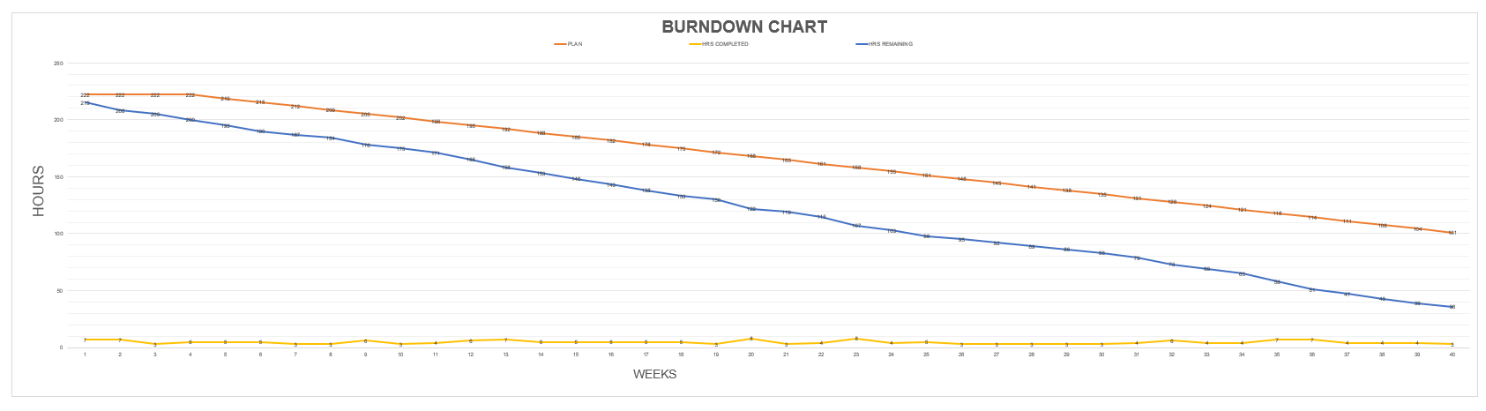
Burndown Chart

Slide 15
ER Model and Mockups

Slide 16
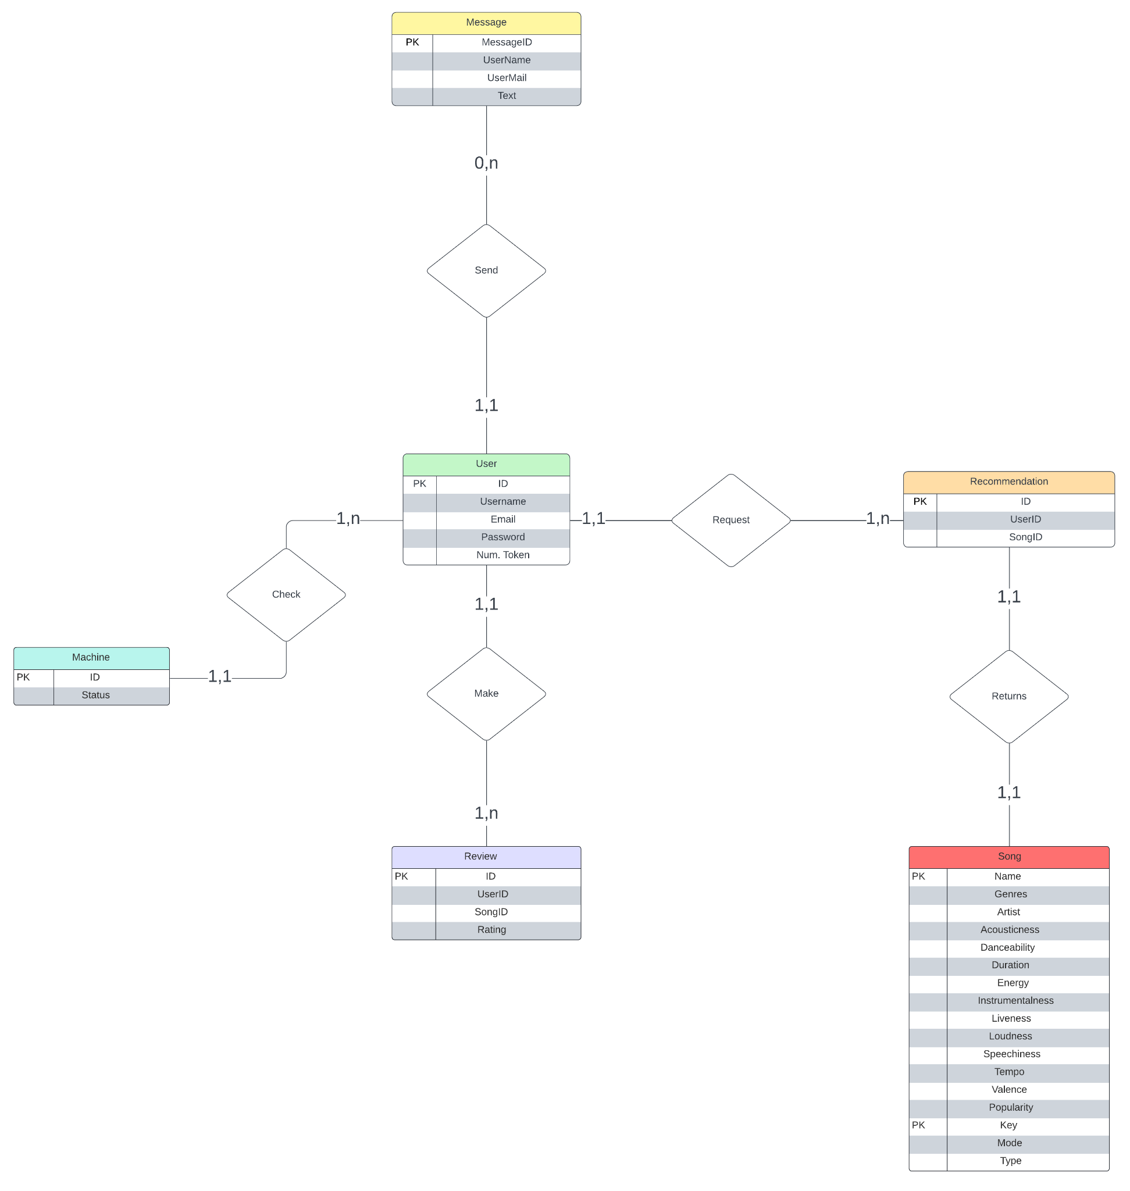
ER Model
Entities:
User
Machine
Message
Review
Recommendation
Song
Relations:
Machine-Check-User
User-Request-Recommendation
User-Make-Review
Recommendation-Returns-Song
User-Send-Message

Slide 17
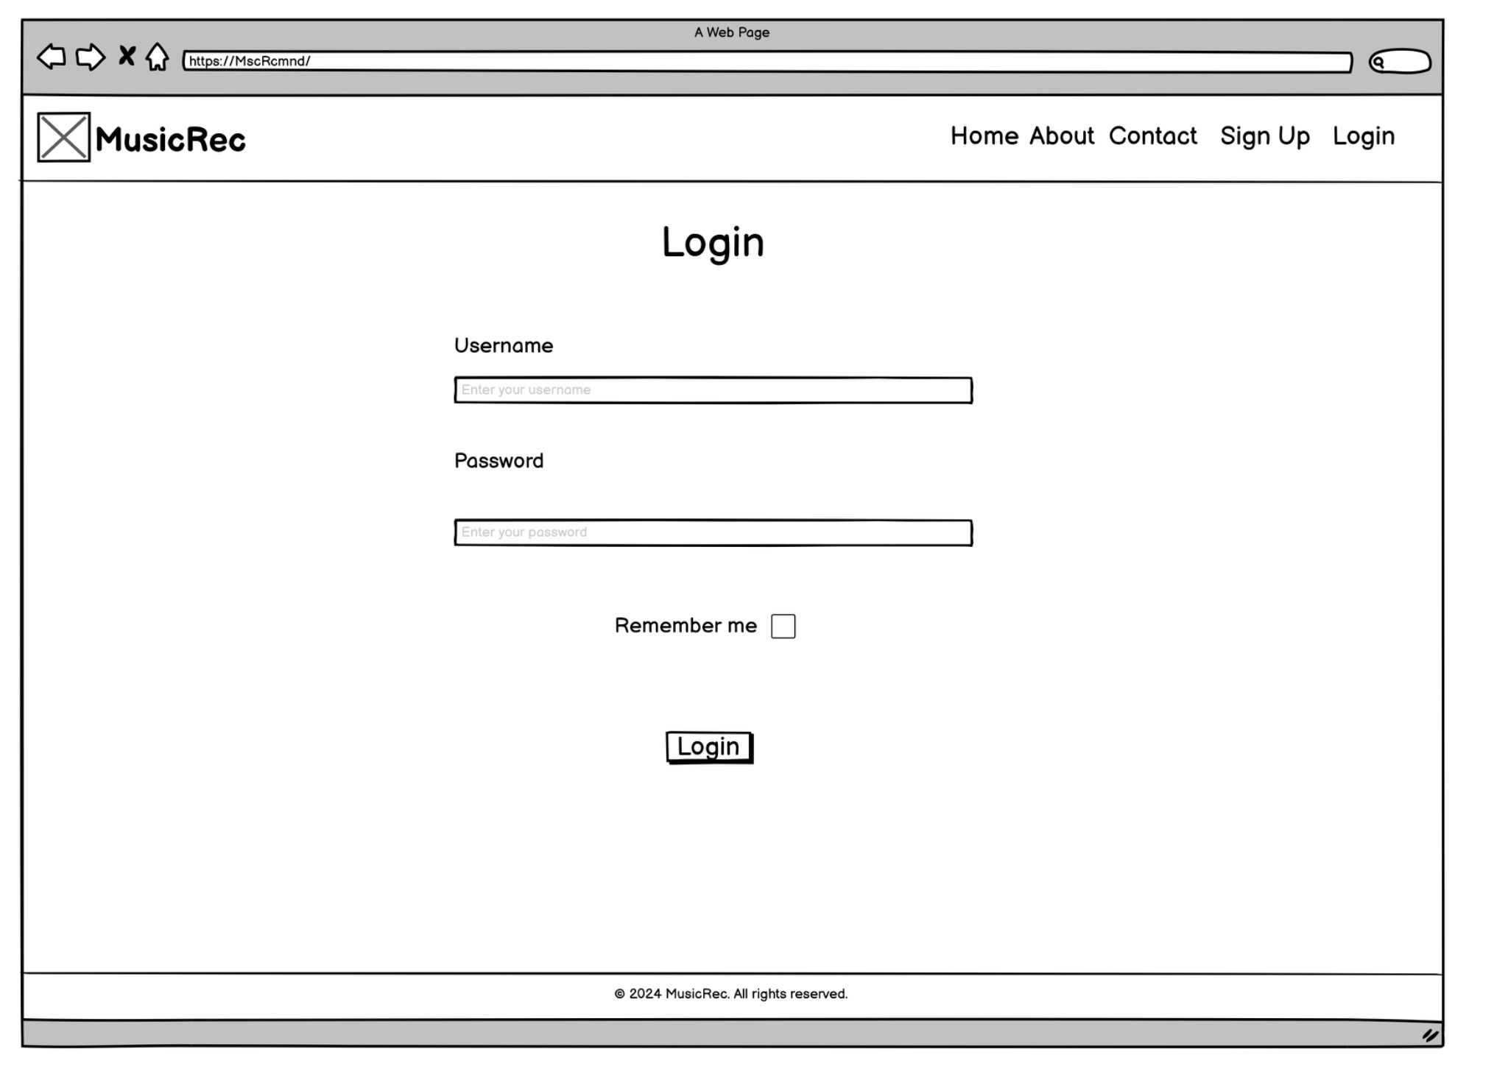
Mockups
Login page

Slide 18
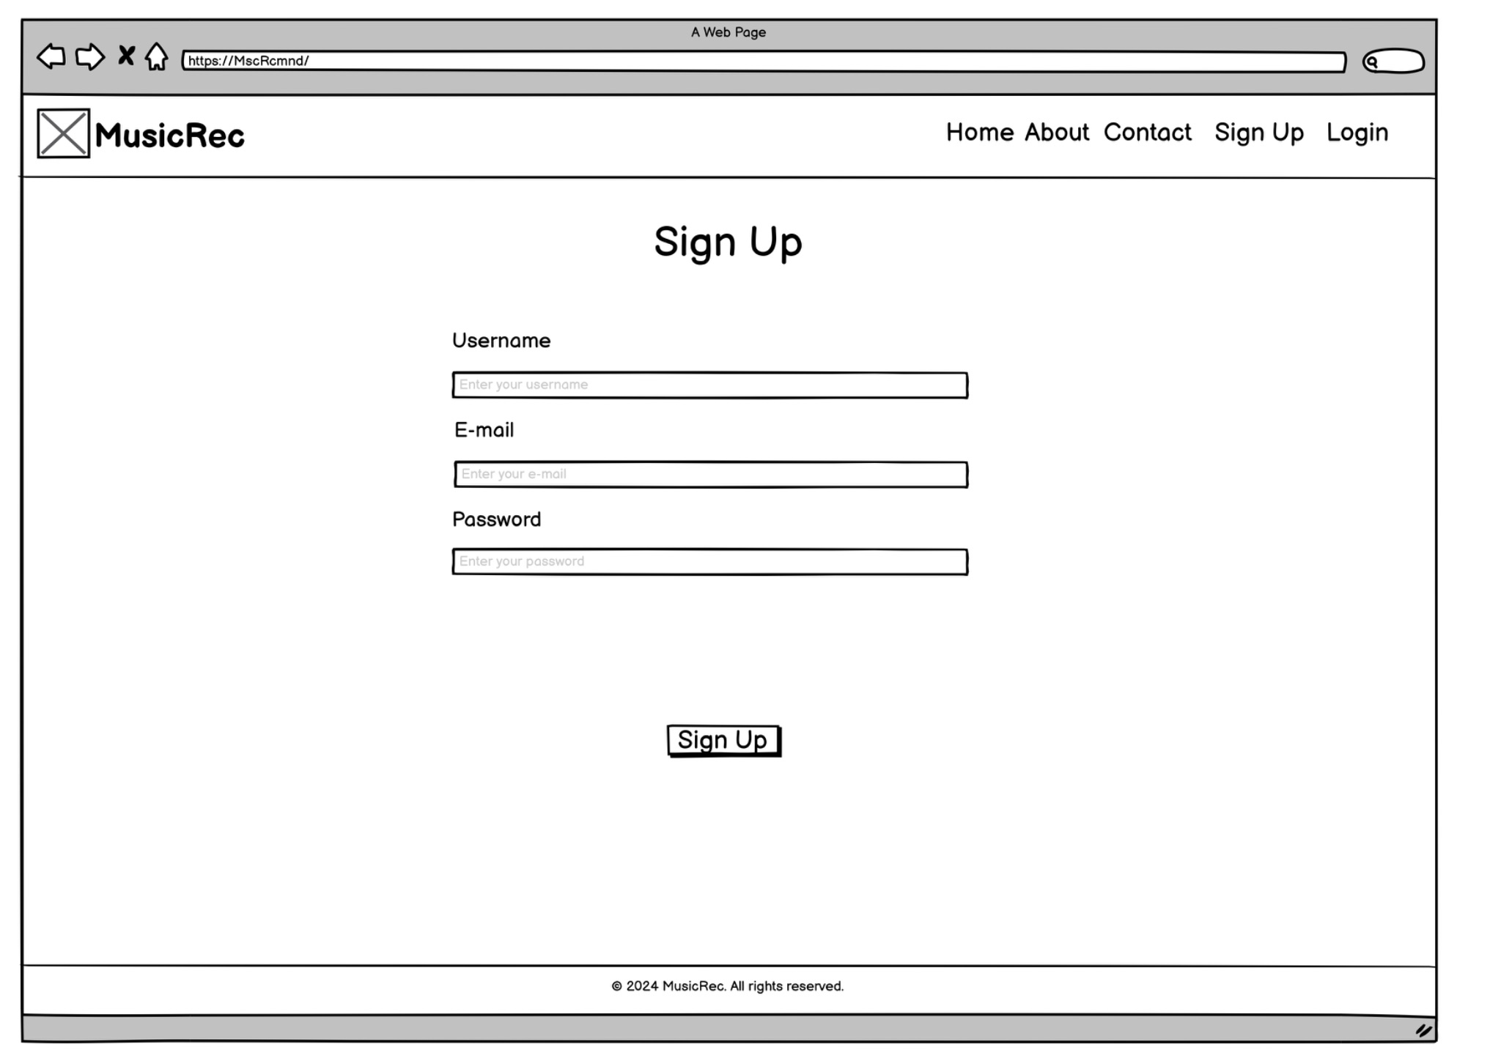
Signup page

Slide 19
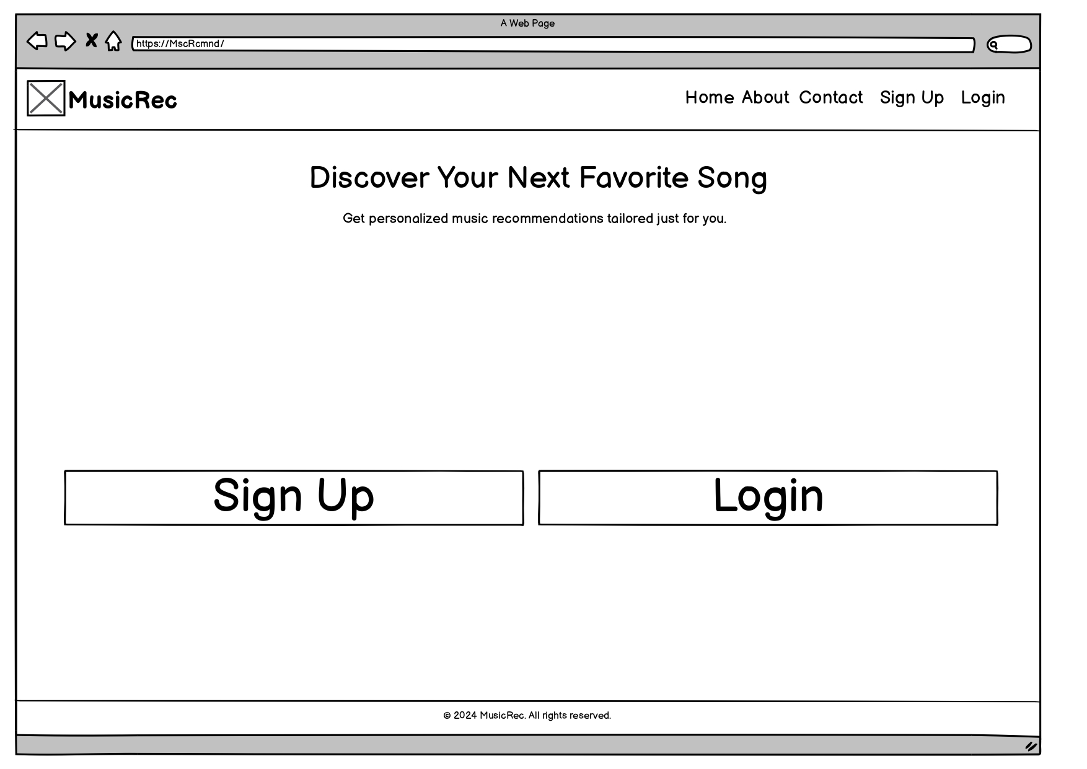
Home page

Slide 20
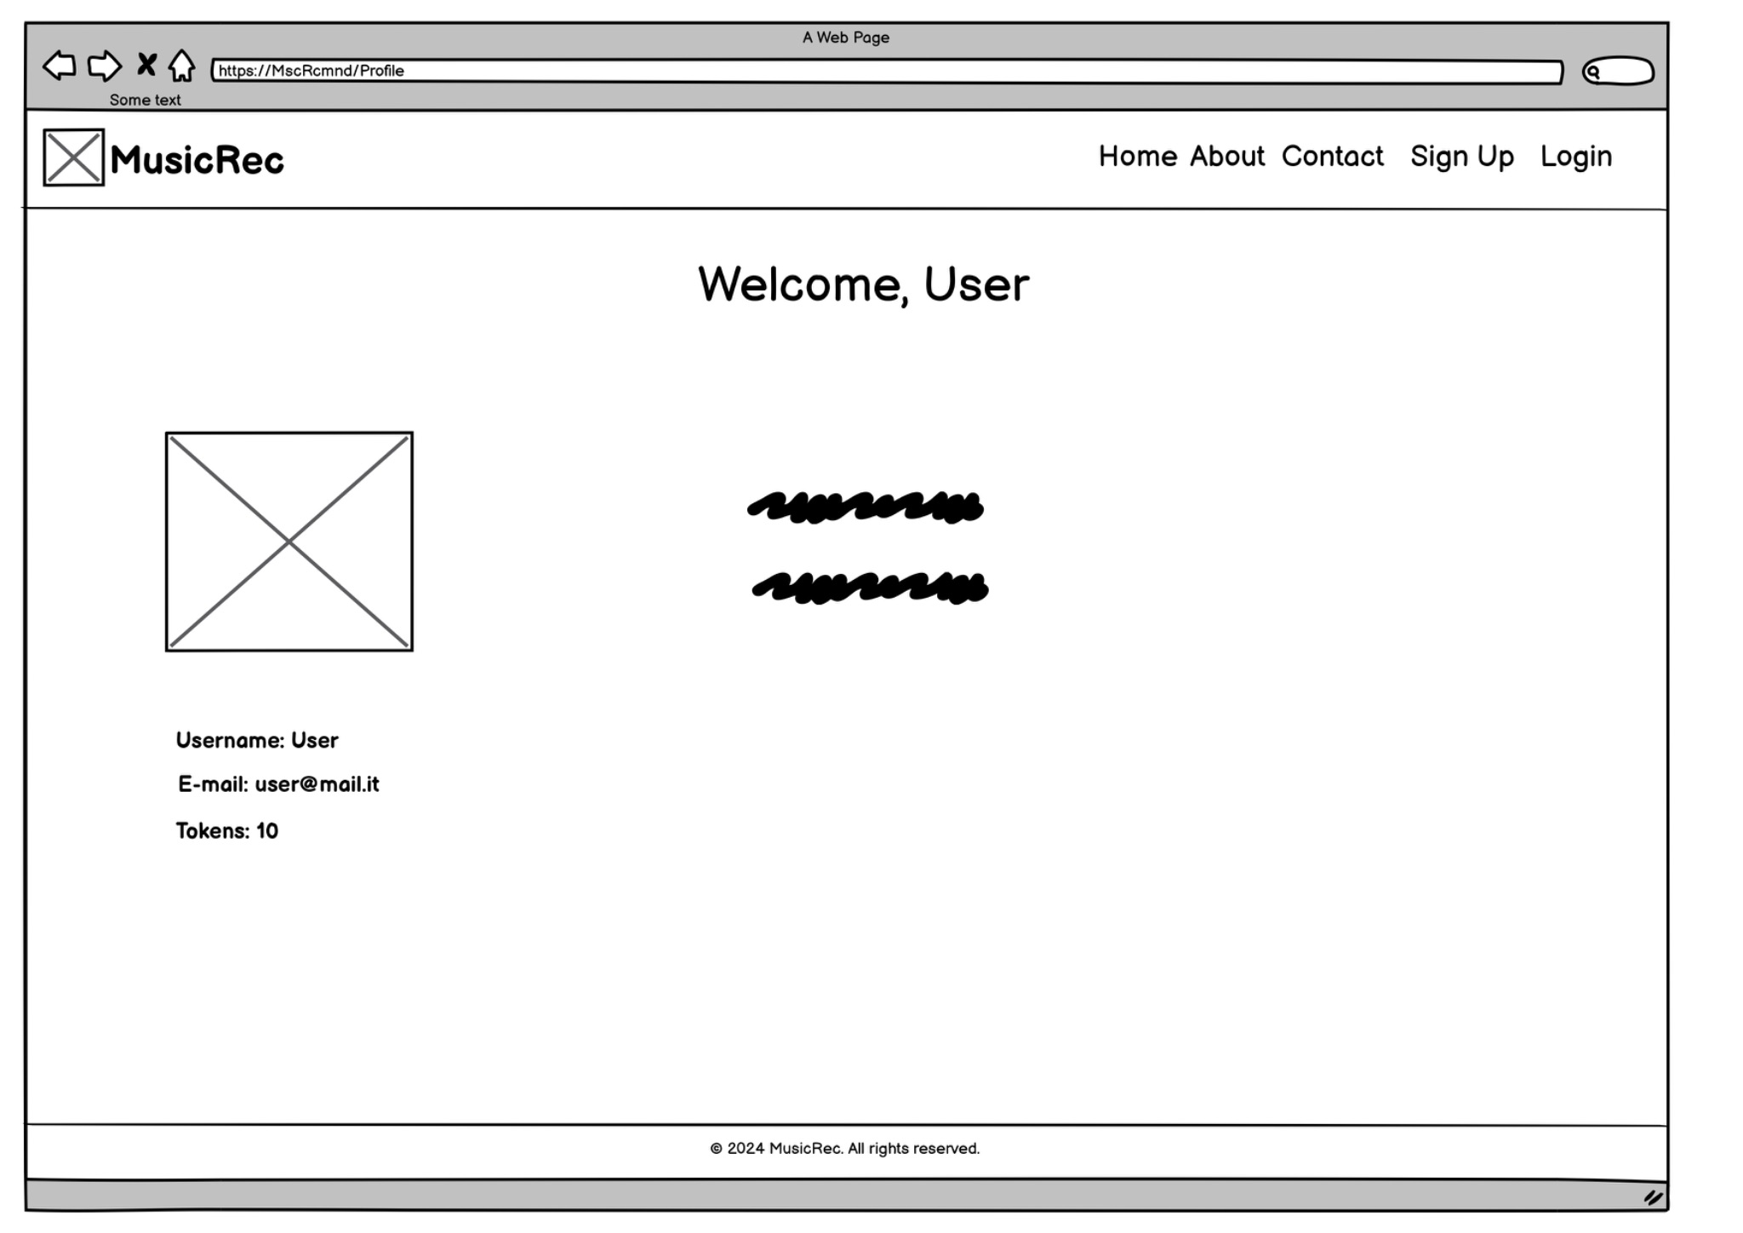
Profile page

Slide 21
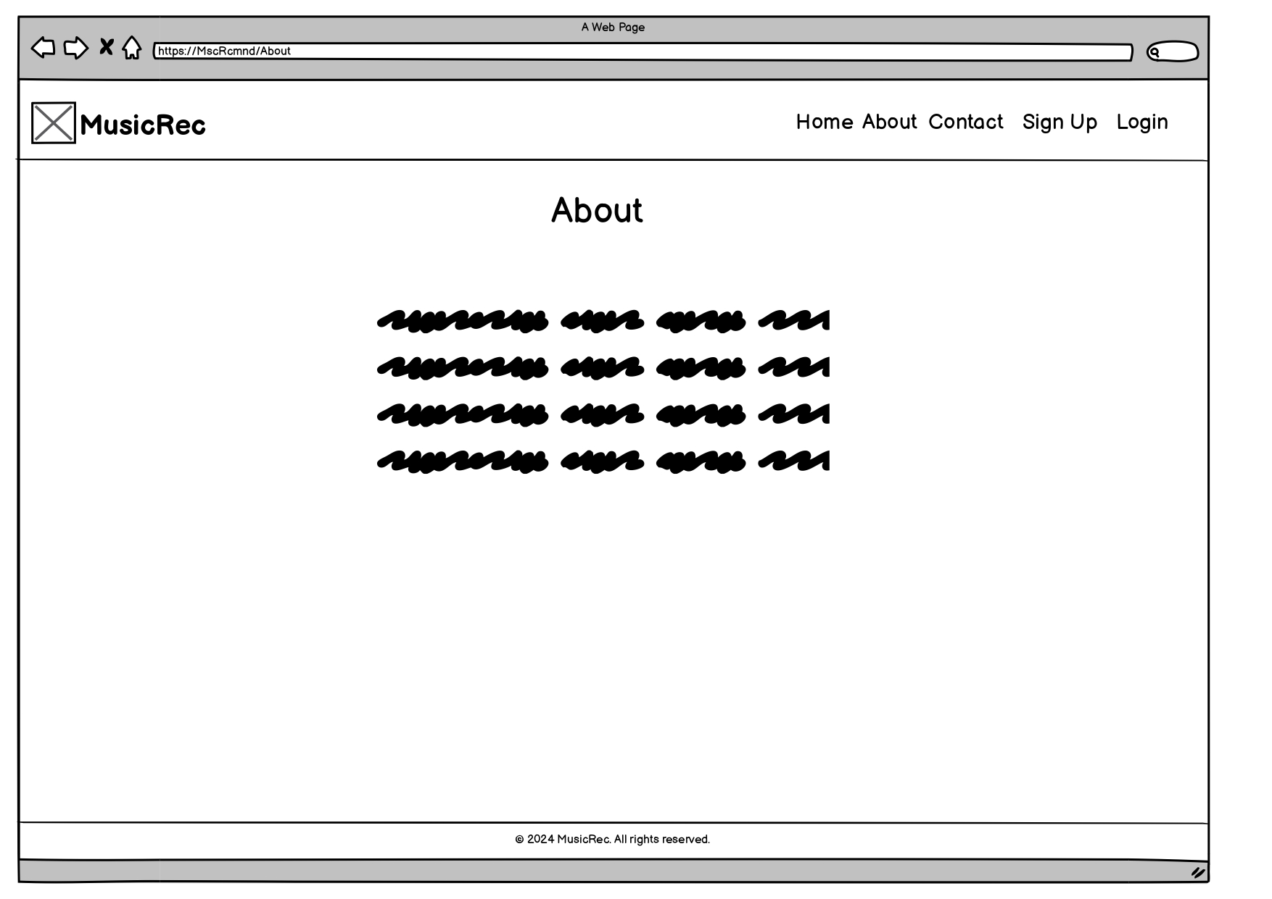
About page

Slide 22
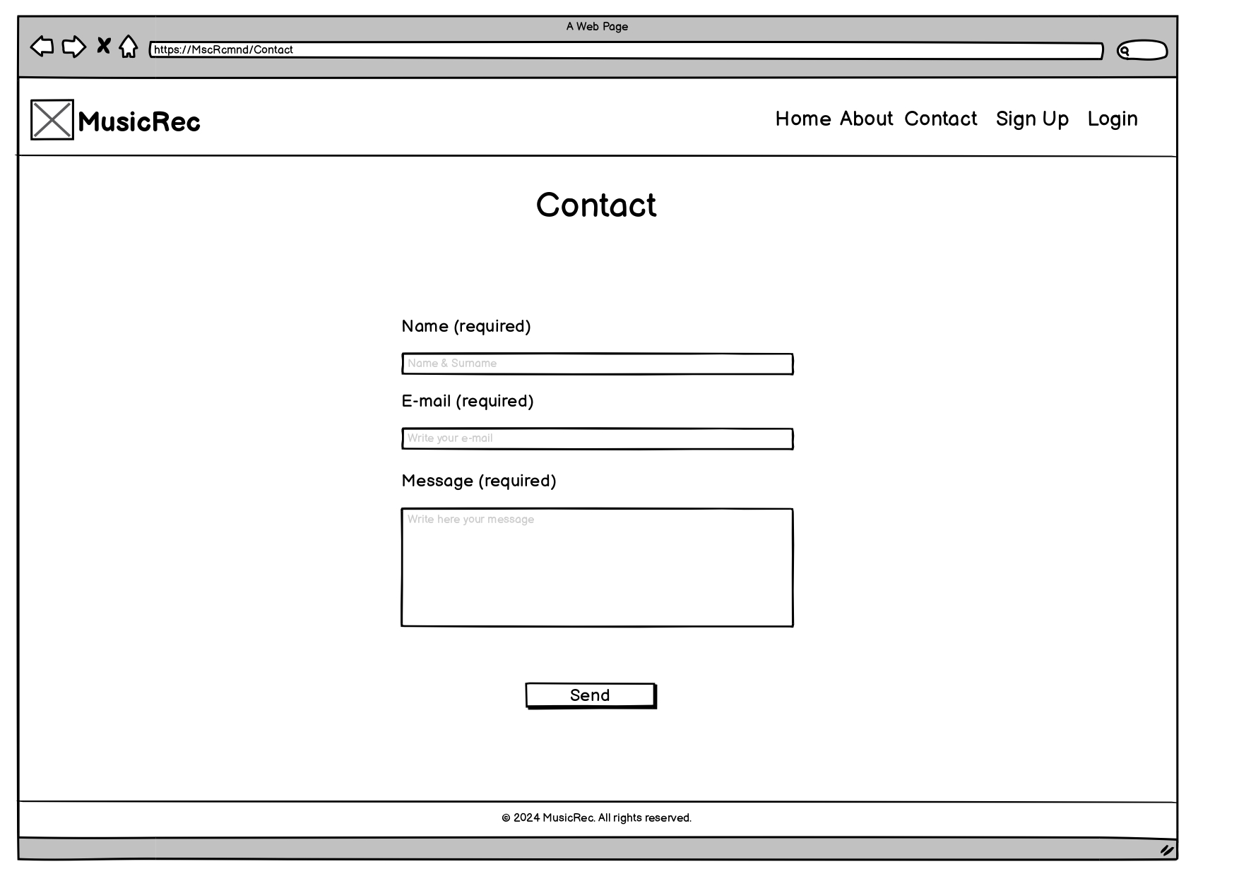
Contact page

